Slide 1
베이즈 정리를 활용한
SMS 스팸 필터링
201511054 컴퓨터과학과 임현

Slide 2


1. Introduction
대상 : 베이즈 정리를 활용한 SMS 스팸 필터링
목적 : 무분별한 스팸 문자로 인한 피해를 줄이고자 함
일정 : 2018 – 06 – 04 ~ 2018 – 06 – 18
도구 :

Slide 3
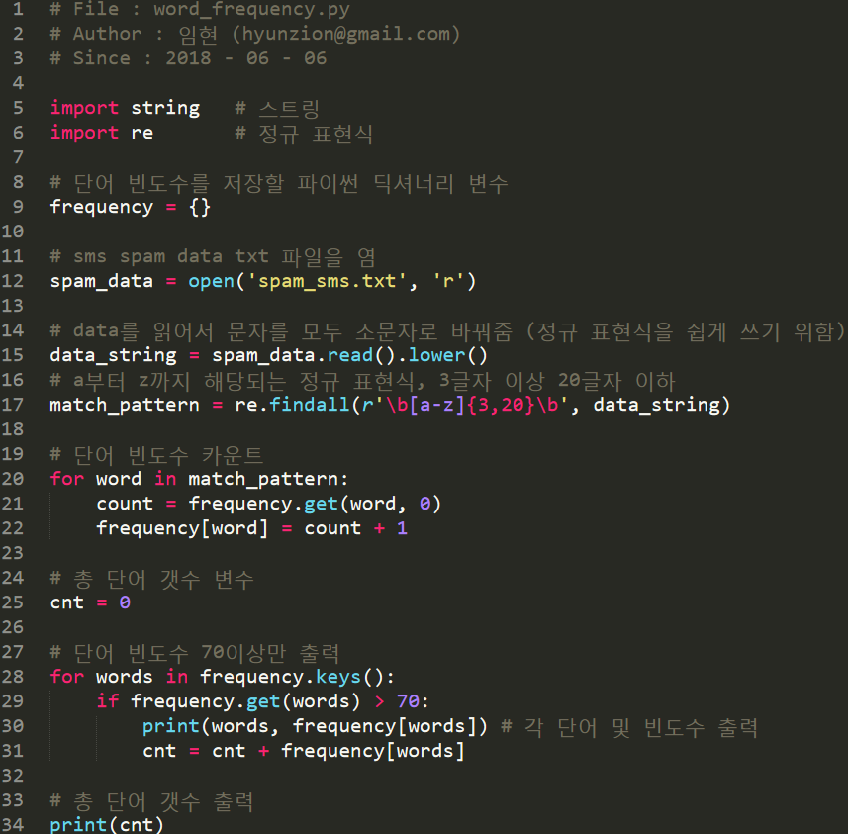
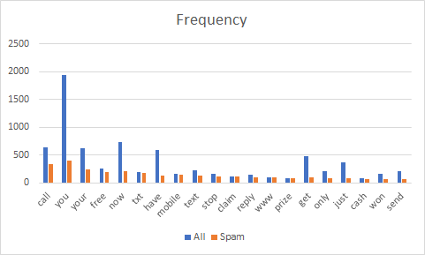
2. 단어 빈도수 분석

Slide 4
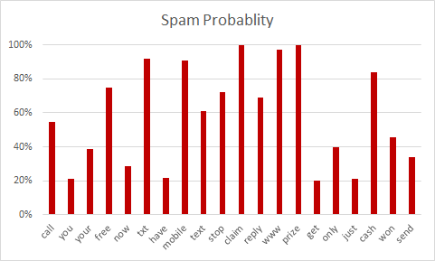
3. 단순 스팸 확률

Slide 5
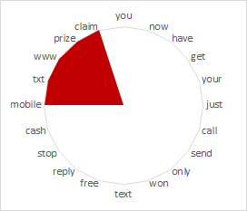
4. 베이즈 정리를 활용한 스팸 확률

Slide 6
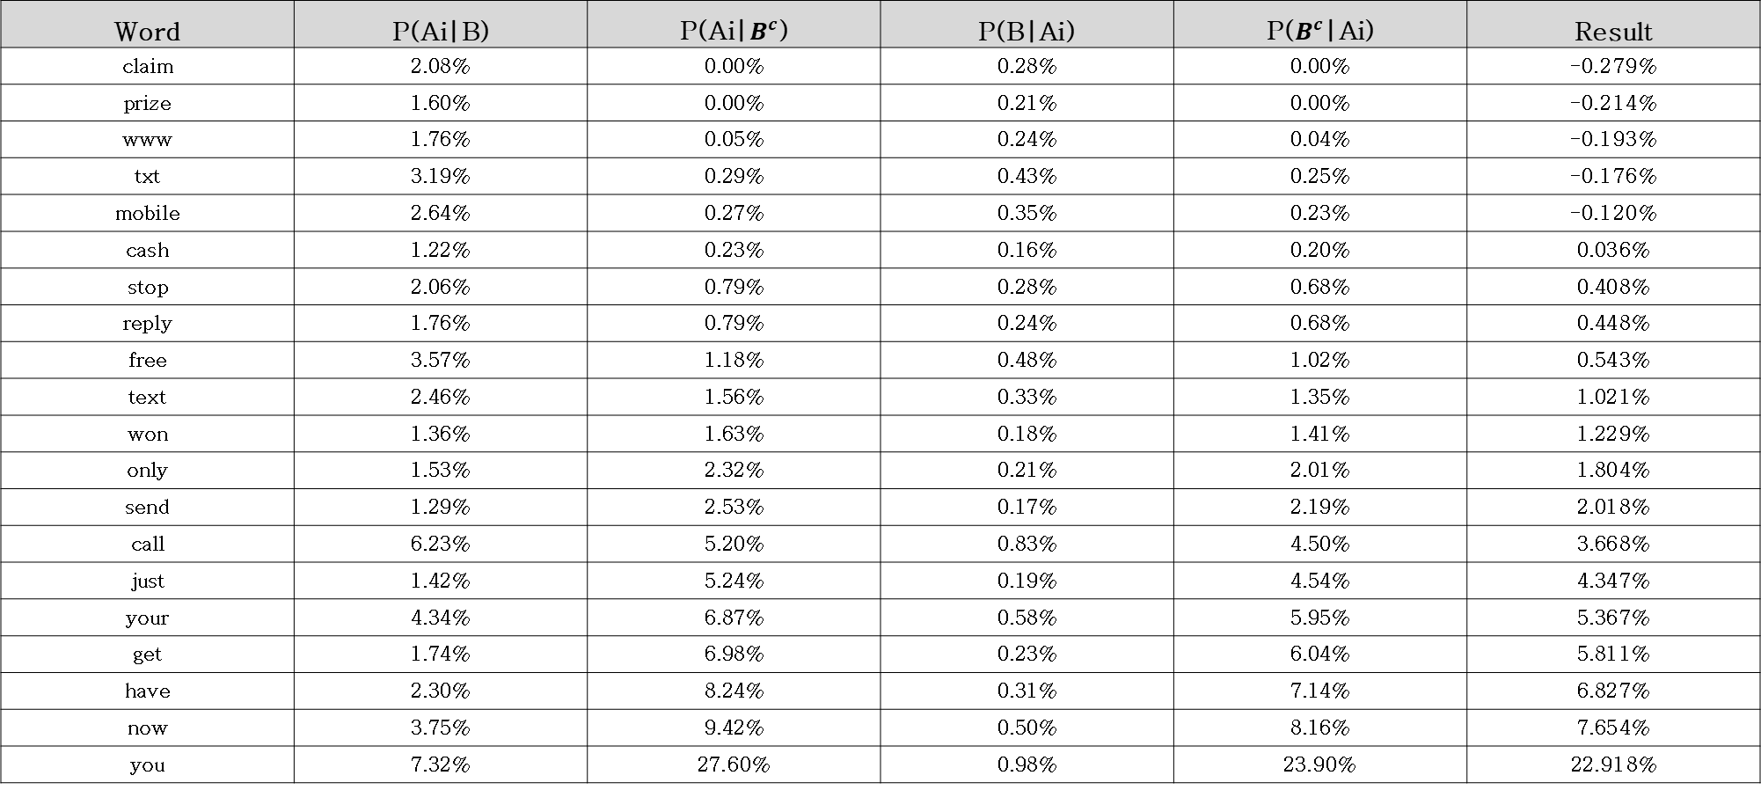
5. Simulation results
Word | P(Ai|B) | P(Ai|$B^{c}$) | P(B|Ai) | P($B^{c}$|Ai) | Result
claim | 2.08% | 0.00% | 0.28% | 0.00% | -0.279%
prize | 1.60% | 0.00% | 0.21% | 0.00% | -0.214%
www | 1.76% | 0.05% | 0.24% | 0.04% | -0.193%
txt | 3.19% | 0.29% | 0.43% | 0.25% | -0.176%
mobile | 2.64% | 0.27% | 0.35% | 0.23% | -0.120%
cash | 1.22% | 0.23% | 0.16% | 0.20% | 0.036%
stop | 2.06% | 0.79% | 0.28% | 0.68% | 0.408%
reply | 1.76% | 0.79% | 0.24% | 0.68% | 0.448%
free | 3.57% | 1.18% | 0.48% | 1.02% | 0.543%
text | 2.46% | 1.56% | 0.33% | 1.35% | 1.021%
won | 1.36% | 1.63% | 0.18% | 1.41% | 1.229%
only | 1.53% | 2.32% | 0.21% | 2.01% | 1.804%
send | 1.29% | 2.53% | 0.17% | 2.19% | 2.018%
call | 6.23% | 5.20% | 0.83% | 4.50% | 3.668%
just | 1.42% | 5.24% | 0.19% | 4.54% | 4.347%
your | 4.34% | 6.87% | 0.58% | 5.95% | 5.367%
get | 1.74% | 6.98% | 0.23% | 6.04% | 5.811%
have | 2.30% | 8.24% | 0.31% | 7.14% | 6.827%
now | 3.75% | 9.42% | 0.50% | 8.16% | 7.654%
you | 7.32% | 27.60% | 0.98% | 23.90% | 22.918%

Slide 7
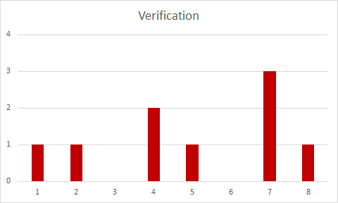
6. Conclusions

Slide 8
감사합니다.

